Slide 1
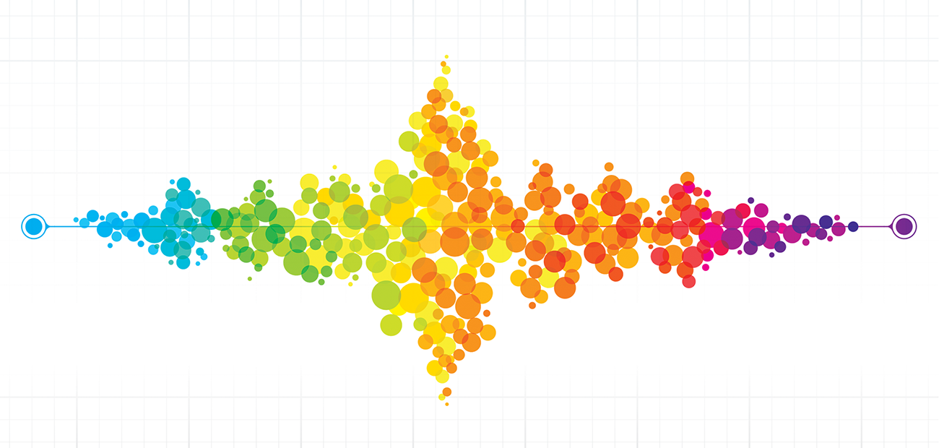
A ROAD to Classification in High Dimensional Space
Paper by Jianqing Fan, Yang Feng, Xin Tong
Presented by Kungania Peter, Kintu Brian

Slide 2
“The quiet statisticians have changed our world; not by discovering new facts or technical developments, but by changing the ways that we reason, experiment and form our opinions ”
Ian Hacking.

Slide 3
Acknowledgements
Dr Dehan Kong
Jianqing Fan, Yang Feng, and Xin Tong
Peng Liu.

Slide 4
Alternatives Prior to ROAD
FISHER DISCRIMINANT ANALYSIS (FDA):
One finds a projection of data point into a line (or generally one finds a projection of data points into a P-1 dimension surface) such that samples from different classes are well separated.
FEATURES ANNEALED INDEPENDENCE RULE (FAIR)::
Instead of using the entire feature space , one selects a subset of important features for classification purposes.
Notes:
Historically FDA is a classification approach named after Ronald Fisher

Slide 5
Issues with the Alternatives in High Dimensions
Limitations of FDA in a ( p > n) setting:
Diverging spectra: eigenvalues do not converge.
Accumulation of noise results into difficulties of estimating population centroids such as mean centre, median centre etc.
Limitations of Independence rule in a ( p > n ) setting
Fails to mitigate the accumulated noise as it utilizes all features.
Since covariance matrix is assumed to be diagonal, Independence rule leads to loss of critical information.
Notes:
Issues with the alternatives in high dimensional space when p is greater than n

Slide 6
How can we incorporate the covariance structure in our analysis with protection against diverging spectra and significant noise accumulation effect ?
STATISTICAL CHALLENGE

Slide 7
Solution
R: regularized.
O: optimal
A: affine
D: discriminant.

Slide 8
What is ROAD?
Is a type of classification that selects an increasing number of features as the regularization relaxes.
What does it mean “to relax a regularization” ?
Recall that in LASSO, as one increases the tuning parameter, one ends up setting the parameters to zero. To “relax a regularization” means that if you reduce the tuning parameter, you decrease the penalization effect.
Objective of ROAD:
We want to find a good data projection direction, say W.

Slide 9
Mission of ROAD
With a focus on a linear classifier, the mission is to find a good data projection direction, say W.

Slide 10
Constrained Coordinate Descent
Used to solve the minimization problem in the ROAD classification procedure
Defined as an algorithm where the p search directions are unit vectors to avoid cases in which convergence is not met
The researchers argue that the coordinate descent algorithm will converge to a minimum since the objective function g(w₁) is strictly convex and that the non-differentiable part in the objective function is separable
Objective Function:
Notes:
Now we will bring up the constrained coordinate descent method. We will use it to solve the minimization problem in the ROAD method.
It is an algorithm where the p search directions are unit vectors

Slide 11
Variants of the ROAD
S-ROAD1:
A screening based ROAD, where we first apply the two-sample t-test in order to obtain the features that are most relevant to the classification
Upon selecting those features, we can apply the ROAD method
S-ROAD2:
Similar to S-ROAD1, expect for each of the feature that S-ROAD1 selects, this method adds another feature that is most correlated to that selected feature
Notes:
Following the idea of independence screening by Fan and Lv (2008) we apply a similar method where we screen all the features before we can apply the ROAD. This gives us the following methods S-ROAD1 and S-ROAD2.
S-ROAD1 is the first of the two screening-based methods. It uses a two-sample t-test in order to select the features that will be the most important for classification. It is important to use the two-sample t-test as it consistently selects the features with different means in the same setting as ours.
Once these features have been selected is when we can apply the ROAD method.
The S-ROAD2 is similar to S-ROAD1 in the sense that it utilizes the two-sample t-test to select relevant features but unlike S-ROAD1 this goes a step further. So that for each of the selected features from the t-test it picks an additional feature that will be most correlated to that feature.
Leaving us with the selected variable from the t-test and also the variables correlated to those that are selected. Now we can apply the ROAD
One benefit to note for the pre-screening is that it helps with the computational cost as there’ll be less features to use in the computation.

Slide 12
Methods for Comparison
DROAD:
Diagonal Regularized Optimal Affine Discriminant
Also a variant of ROAD
The DROAD uses the diagonal of the covariance matrix to estimate direction w
Independence-based method that will fail when p is large
Notes:
Before we can discuss about the simulations I just want to go over some of methods that we’ll be using to compare the ROAD method and its variants.
The difference that should be noted between DROAD and ROAD is that the DROAD uses a diagonal covariance matrix to estimate the direction w_c.
Still an independent based method like the NSC, FAIR and NB

Slide 13
Methods for Comparison
FAIR (Feature Annealed Independence Rule):
Selects a subset of important features that will be used for classification and applies the Independence Rule to only those features
Aims to reduce the accumulation of noise from using the entire feature space when p>n
NSC (Nearest Shrunken Centroid)
SCRDA (Shrunken Centroids Regularized Discriminant Analysis):
SCRDA incorporates correlation structures
Oracle
Notes:
Unlike any of the other methods for comparison that I’ve mentioned so far, SCRDA is incorporates the correlation structure so it does not fail when p is large. However the ROAD still outperforms it in all correlation settings

Slide 14
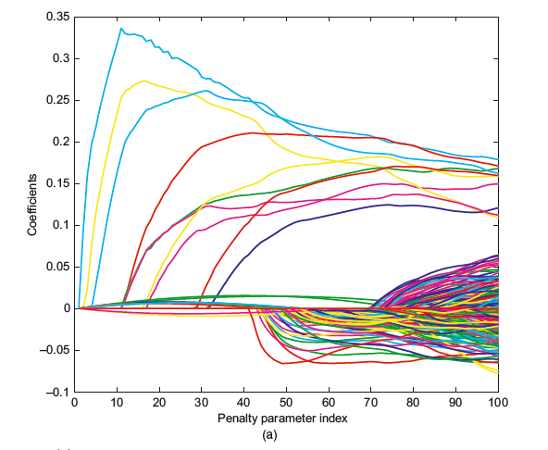
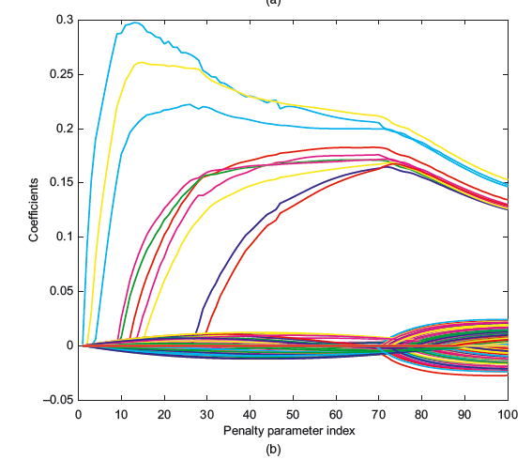
Variable Selection of “ROAD” and “DROAD”
(a) Solution path for ROAD
(b) Solution path for DROAD
Both with correlation setting p=0.5 and sparse signal (s₀)
Notes:
Now we will go over the simulations that were conducted in the paper

Slide 15
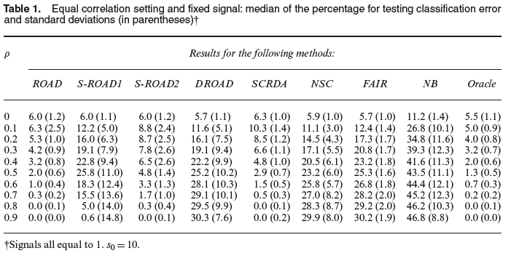
Median Testing Classification Error
Equal correlation setting and fixed signal: median of the percentage for testing classification error with the standard deviations in parentheses

Slide 16
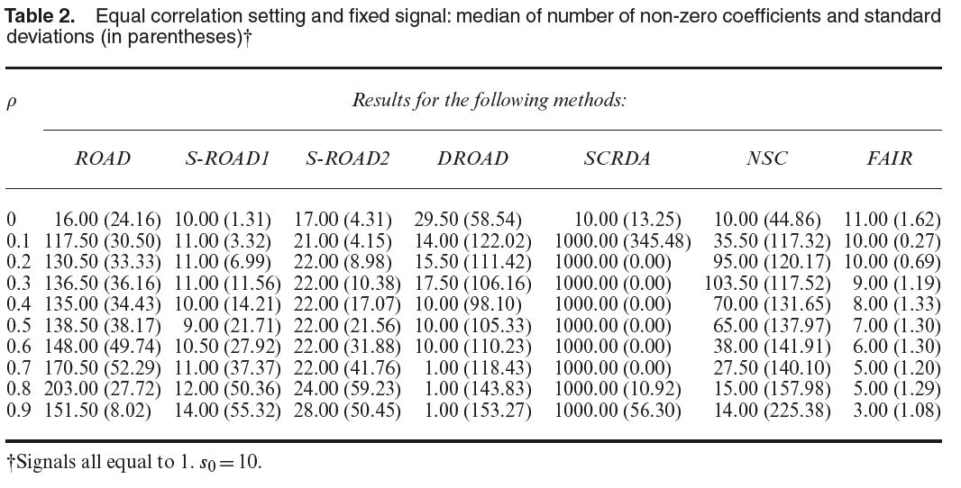

Slide 17
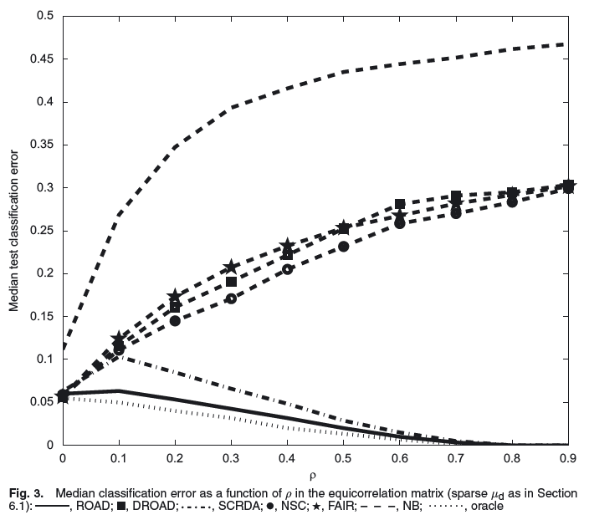
Median Test Classification Error

Slide 18
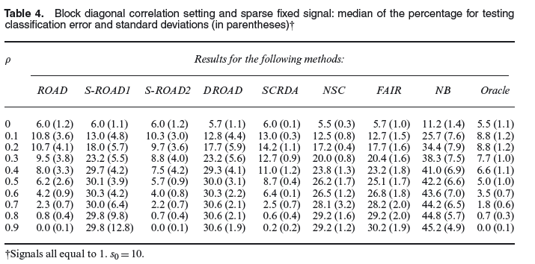
Block Diagonal Correlation Setting
Notes:
In this case we have our covariance matrix to be a block diagonal matrix where the first block is a 20 by 20 equicorrelated matrix and the second block is a (p-20) by (p-20) equicorrelated matrix

Slide 19
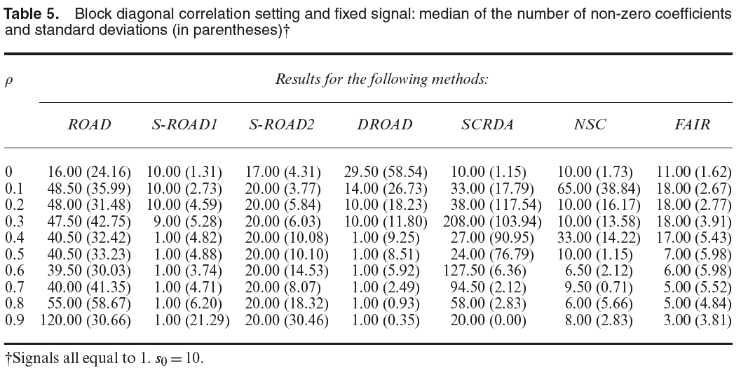
Block Diagonal Correlation Setting

Slide 20
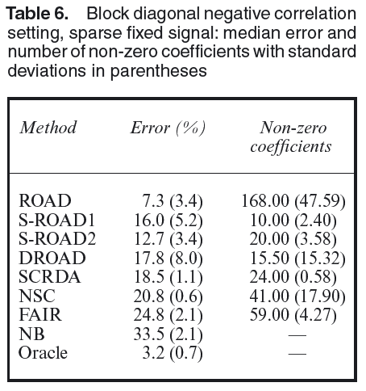
Block Diagonal Negative Correlation Setting
Sigma is taken to be block diagonal with each block size equal to 10
Each block is an equicorrelated matrix with correlation -0.1

Slide 21
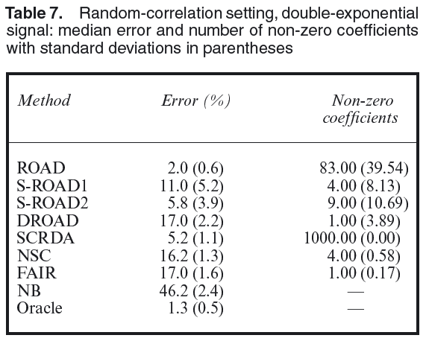
Random Correlation Setting
This is the case we take a random matrix sigma as the correlation structure.
Notes:
The paper goes into more depth about how to calculate the random covariance matrix sigma

Slide 22
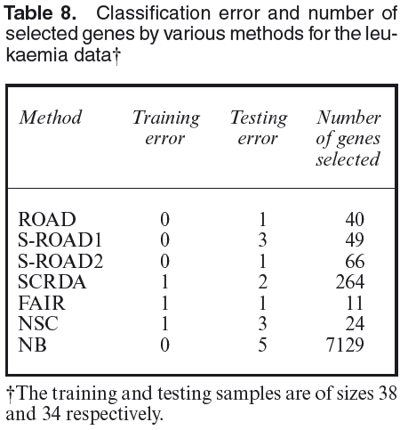
Simulation of “ROAD” with Real Data
Leukemia Data:
p = 7129 genes
Training
n₁ = 27 acute lymphoblastic leukemia
n₂ = 11 acute myeloid leukemia
Testing
n₁ = 20 acute lymphoblastic leukemia
n₂ = 14 acute myeloid leukemia
Notes:
ROAD outperforms all other methods, with ROAD2 having similar results but with more features selected

Slide 23
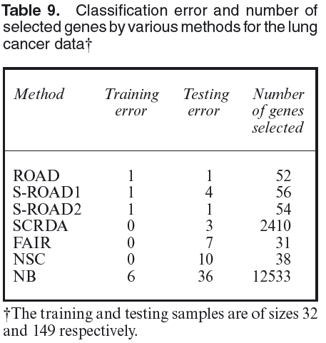
Simulation of “ROAD” with Real Data
Lung Cancer Data:
p = 12533 genes
Training:
n₁ = 16 adenocarcinoma
n₂ = 16 mesothelioma
Testing:
n₁ = 134 adenocarcinoma
n₂ = 15 mesothelioma
Notes:
ROAD Still outperforms everything and SROAD2 having similar results but ROAD had less features selected

Slide 24
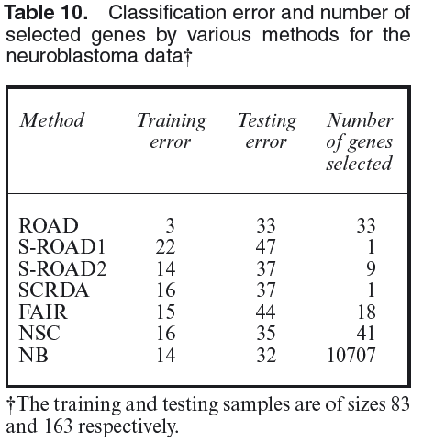
Simulation of “ROAD” with Real Data
Neuroblastoma Data:
p = 10707 genes
Training:
19 patients positive (survived)
64 patients negative (did not survive)
Testing:
30 patients positive (survived)
126 patients negative (did not survive)
156

Slide 25
Conclusion
ROAD incorporates an unregularized pooled sample covariance matrix and sample mean difference vector which avoids curse of dimensionality and does not suffer from accumulation of noise
In all the cases seen ROAD outperforms all independence based rules
ROAD has a competitive classification error when compared to other methods

Slide 26
“In God we Trust, all others bring data”
William Edwards Deming (1900-1993)

